Slide 1
USED CAR PRICE PREDICTION
Submitted By
Girija Chandra Mohan

Slide 2
ACKNOWLEDGMENT
I would like to express my gratitude to my guide Khusboo Garg (SME, Flip Robo) for her constant guidance, encouragement and unconditional help towards the development of this Used Car Price Prediction project. She helped me whenever I got stuck somewhere in between. The project would have not been completed without her support and confidence.
Also, I have utilized a few external resources that helped me to complete the project. I ensured that I learn from the samples and modify things according to my project requirement.

Slide 3
All the external resources that were used in creating this project are listed below:
1) https://www.google.com/
2) https://www.youtube.com/
3) https://scikit-learn.org/stable/user_guide.html
4) https://github.com/
5) https://www.kaggle.com/
6) https://medium.com/
7) https://towardsdatascience.com/
8) https://www.analyticsvidhya.com/
9) https://www.olx.com/

Slide 4
Business Problem Framing
Automobiles sector has been under pressure due to a mix of demand and supply factors.
The Indian automotive sector was already struggling in FY20. before the Covid-19 crisis. It saw an overall degrowth of nearly 18 per cent.
This situation was worsened by the onset of the Covid-19 pandemic and the ongoing lockdowns across India and the rest of the world.
These two years (FY20 and FY21) are challenging times for the Indian automotive sector on account of slow economic growth, negative consumer sentiment, BS-VI transition, changes to the axle load norms, liquidity crunch, low-capacity utilisation and potential bankruptcies.

Slide 5
DATA COLLECTION PHASE
You have to scrape at least 5000 used cars data. You can scrape more data as well, it’s up to you. more the data better the model
In this section You need to scrape the data of used cars from websites (OLX, Car Dekho, Cars 24 etc.) You need web scraping for this. You have to fetch data for different locations. The number of
columns for data doesn’t have limit, it’s up to you and your creativity. Generally, these columns are Brand, model, variant, manufacturing year, driven kilometers, fuel, number of owners, location and at last target variable Price of the car. This data is to give you a hint about important variables in used car model. You can make changes to it, you can add or you can remove some columns, it completely depends on the website from which you are fetching the data.
Try to include all types of cars in your data for example- SUV, Sedans, Coupe, minivan, Hatchback.

Slide 6
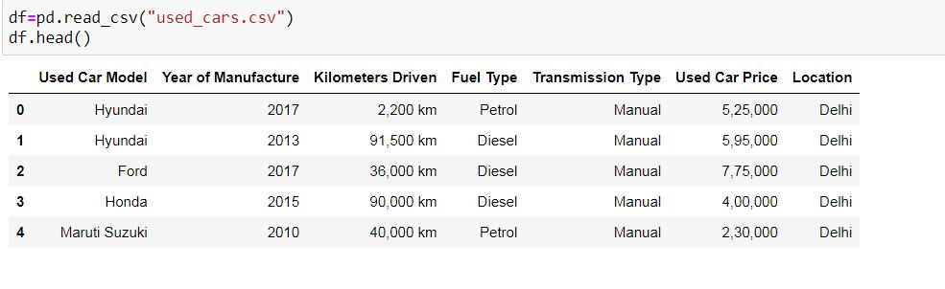

Slide 7
MODEL BUILDING PHASE
After collecting the data, you need to build a machine learning model. Before model building do all data pre-processing steps. Try different models with different hyper parameters and select the best model. Follow the complete life cycle of data science. Include all the steps below.
1. Data Cleaning
2. Exploratory Data Analysis
3. Data Pre-processing
4. Model Building
5. Model Evaluation
6. Selecting the best model

Slide 8
DATA PREPROCESSING
Importing the necessary dependencies and libraries.
Reading the CSV file and converted into data frame.
Checking the data dimensions for the original dataset.
Looking for null values and accordingly fill the missing data.
Checking the summary of the dataset.
Checking unique values.
Checking all the categorical columns in the dataset.

Slide 9
Visualizing each features using matplotlib and seaborn.
Performing encoding using the Label encoder on categorical features.
Checking for co-relation/multi-collinearity in a heatmap.
Checking for Outliers/Skewness using boxen plot and distribution plot.
Perform Scaling using Standard Scaler method.
Checking for the final dimension of dataset to confirm the input details.
Creating train test split and the best random state found in the range 1-100.

Slide 10
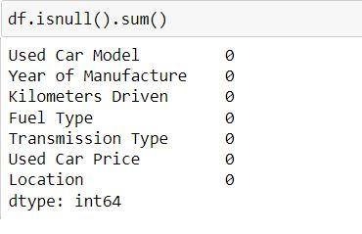
Check For Null Values
Null values in a dataset are to be filled with appropriate statistical values to get better results.

Slide 11
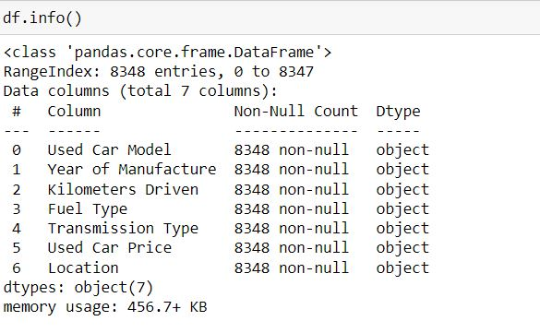
Handling the Data
All the features in the dataset are of object type, they are to be handled properly for further processing.

Slide 12
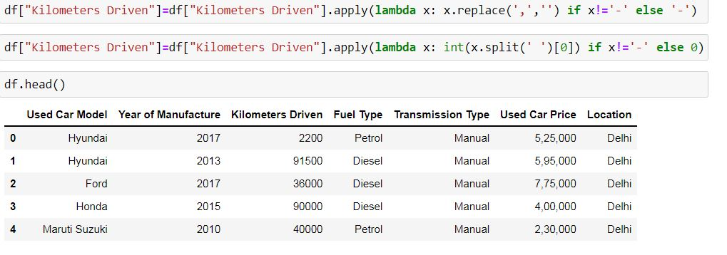
The various data processing performed on the data set is shown below with the code.

Slide 13
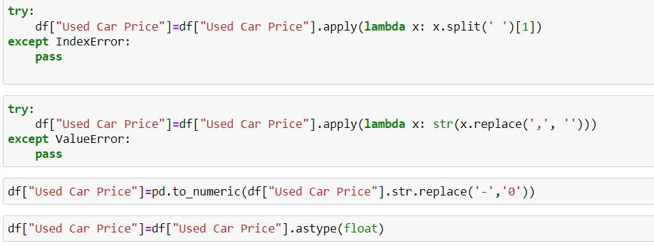
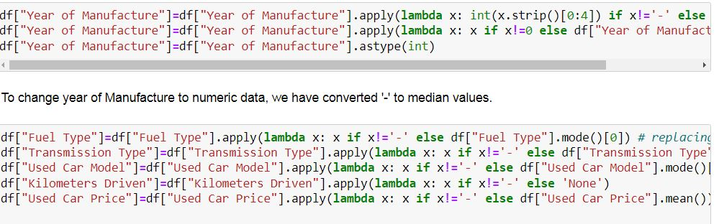

Slide 14
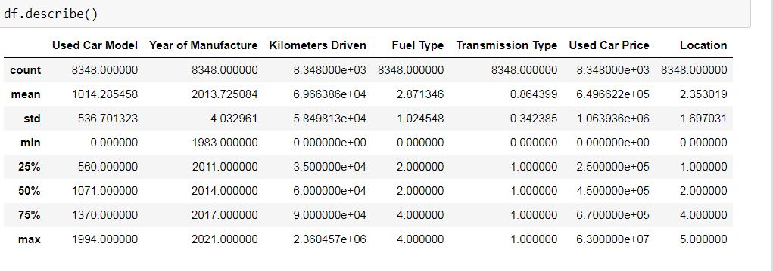
STATISTICAL SUMMARY
In descriptive statistics, summary statistics are used to summarize a set of observations, in order to communicate the largest amount of information as simply as possible. Summary statistics summarize and provide information about your sample data. It tells something about the values in data set. This includes where the average lies and whether the data is skewed.
The describe() function computes a summary of statistics pertaining to the Data Frame columns. This function gives the mean, count, max, standard deviation and IQR values of the dataset in a simple understandable way.

Slide 15
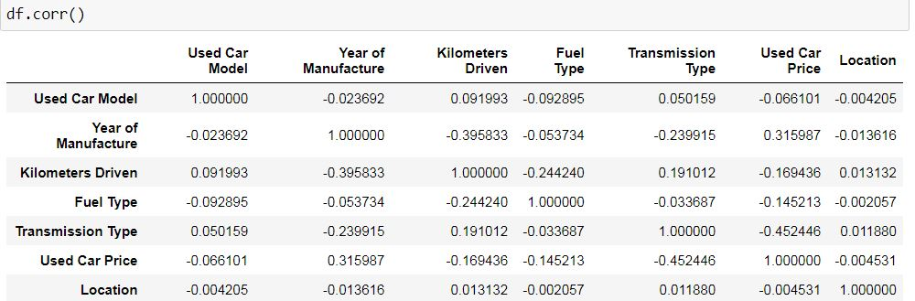
CORRELATION FACTOR
The statistical relationship between two variables is referred to as their correlation. The correlation factor represents the relation between columns in a given dataset.
A correlation can be positive, meaning both variables are moving in the same direction or it can be negative, meaning that when one variable's value increasing, the other variable’s value is decreasing.

Slide 16
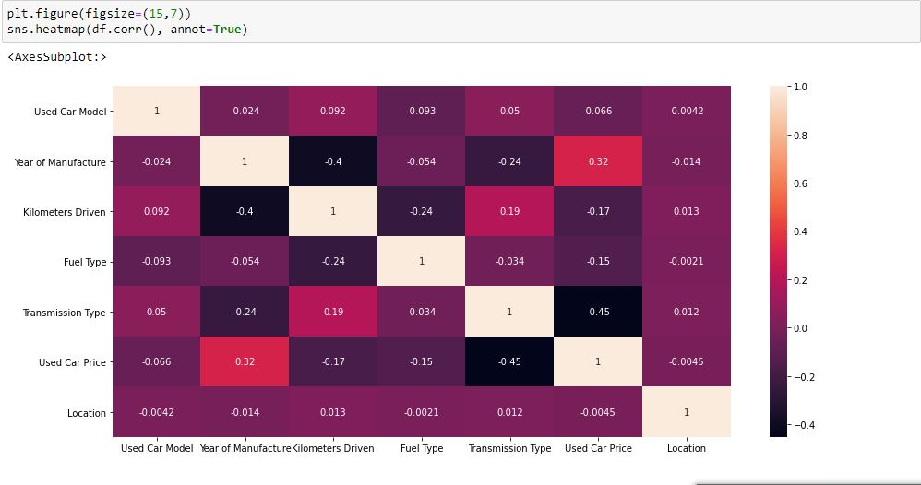
CORRELATION MATRIX AND ITS VISUALIZATION
A correlation matrix is a tabular data representing the ‘correlations’ between pairs of variables in a given dataset. It is also a very important pre-processing step in Machine Learning pipelines.
It is a data analysis representation that is used to summarize data to understand the relationship between different variables of given dataset.

Slide 17
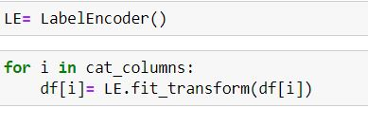
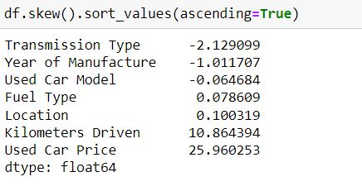
ENCODING NON-NUMERIC DATA USING LABEL ENCODER AND SKEWNESS REMOVAL
CHECKING SKEWNESS
Skewness refers to distortion or asymmetry in a symmetrical bell curve, or normal distribution in a set of data. Besides positive and negative skew, distributions can also be said to have zero or undefined skew. The skewness value can be positive, zero, negative, or undefined.

Slide 18
CHECKING OUTLIERS
An outlier is a data point in a data set which is distant or far from all other observations available. It is a data point which lies outside the overall distribution which is available in the dataset. In statistics, an outlier is an observation point that is distant from other observations.
A box plot is a method or a process for graphically representing groups of numerical data through their quartiles. Outliers may also be plotted as an individual point. If there is an outlier it will plotted as point in box plot but other numerical data will be grouped together and displayed as boxes in the diagram. In most cases a threshold of 3 or -3 is used i.e., if the Z-score value is higher than or less than 3 or -3 respectively, that particular data point will be identified as outlier.

Slide 19
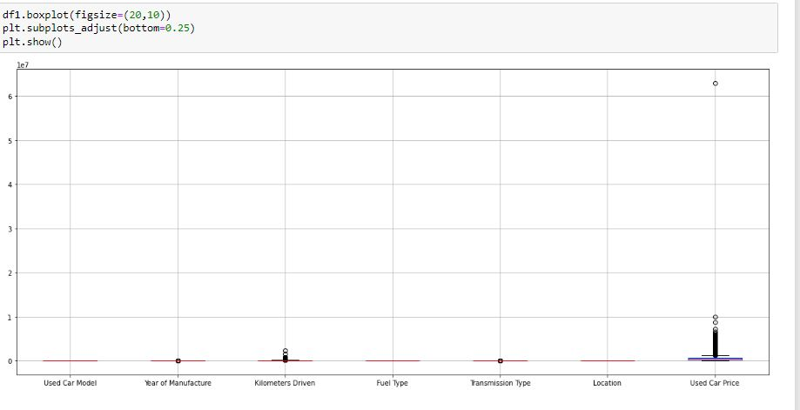

Slide 20

TREATING SKEWNESS
Skewness can be treated in different ways.
Log Transform
Squareroot Transform
Power Transform
Box-cox Transform
Here we use power Transform to treat skewness.

Slide 21
HARDWARE AND SOFTWARE REQUIREMENTS AND TOOLS USED
For doing this project, the hardware used is a laptop with high end specification and a stable internet connection. While coming to software part, I had used anaconda navigator and in that I have used Jupyter notebook to do my python programming and analysis.
For using a csv file, Microsoft excel is needed. In Jupyter notebook, I had used lots of python libraries to carry out this project and I have mentioned below with proper justification:
1. Pandas- a library which is used to read the data, visualisation and analysis of data.
2. NumPy- used for working with array and various mathematical techniques.
3. Seaborn- visualization tool for plotting different types of plot.
4. Matplotlib- It provides an object-oriented API for embedding plots into applications.
5. zscore- technique to remove outliers.
6. skew ()- to treat skewed data using various transformation like sqrt, log, cube, boxcox, etc.
7. standard scaler- I used this to scale my data before sending it to model.
8. train_test_split- to split the test and train data.
9. Then I used different classification algorithms to find out the best model for predictions.
10. joblib- library used to save the model in either pickle or obj file

Slide 22
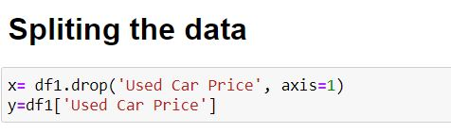
TESTING OF IDENTIFIED APPROACHES
After completing the required pre-processing techniques for the model building data is separated as input and output columns before passing it to the train_test_split.

Slide 23
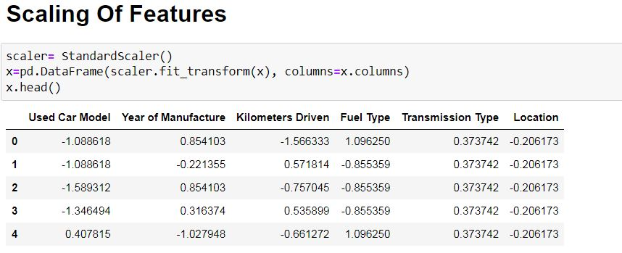
SCALING THE DATA USING STANDARD SCALER

Slide 24
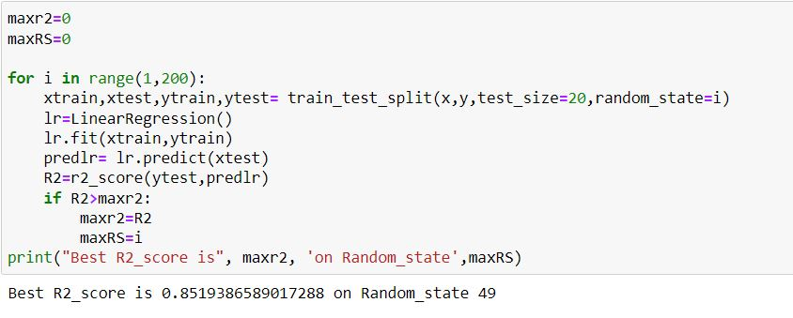
EVALUATE SELECTED MODELS
We will find the best Random State and C fold to run and evaluate the models.

Slide 25
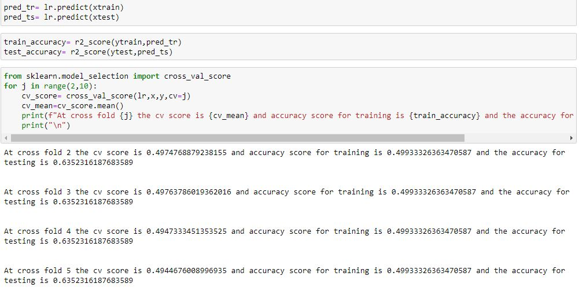

Slide 26
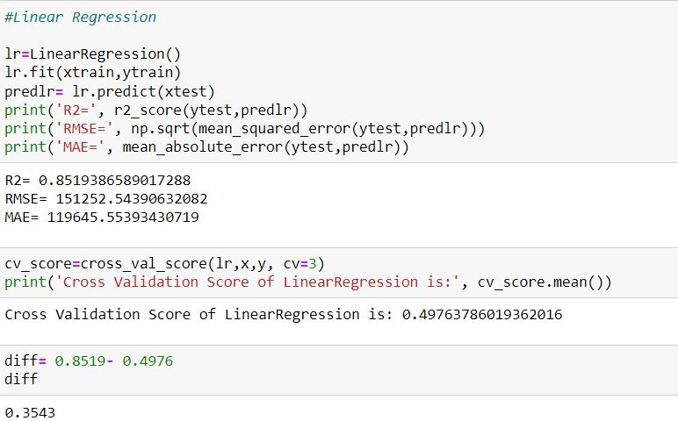
The best random state is found to be 49, cv=7. We shall run the other models with this random state and cv.
Linear Regression

Slide 27
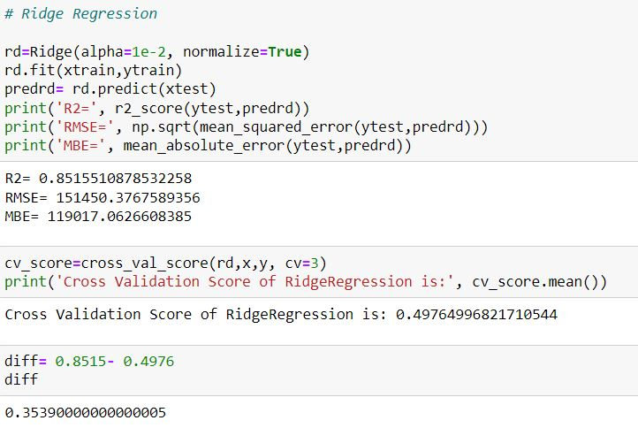
Ridge Regression

Slide 28
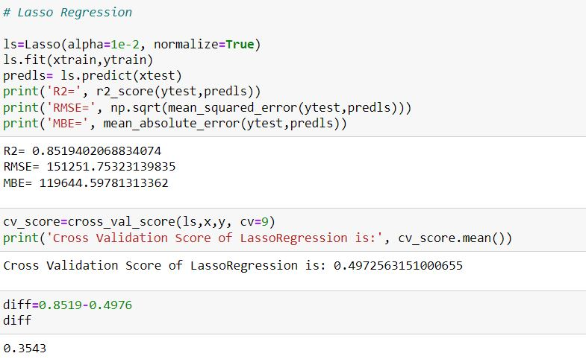
Lasso Regression

Slide 29
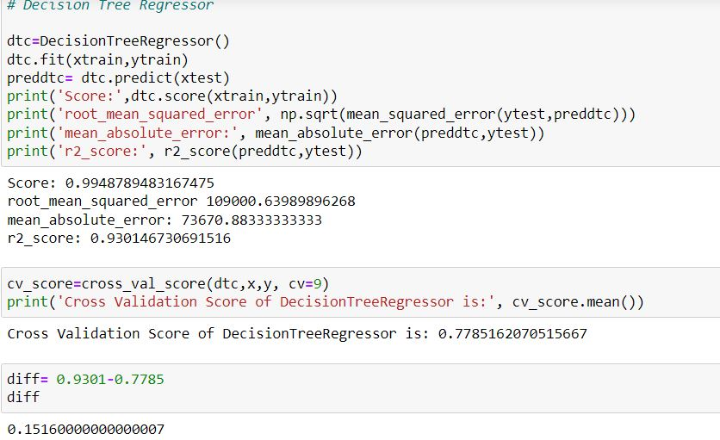
Decision Tree Regressor

Slide 30
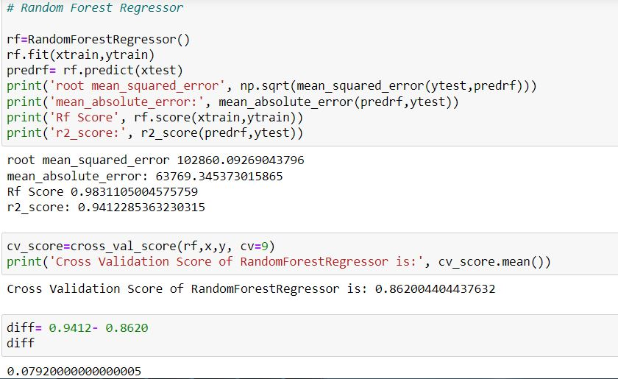
Random Forest Regressor

Slide 31
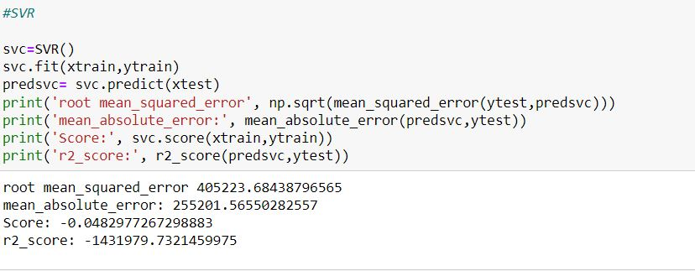
SVR

Slide 32
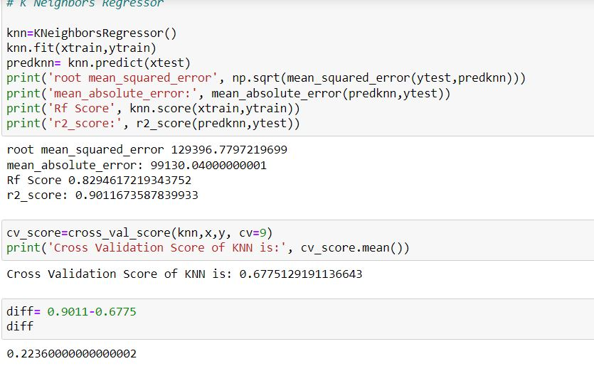
KNN

Slide 33
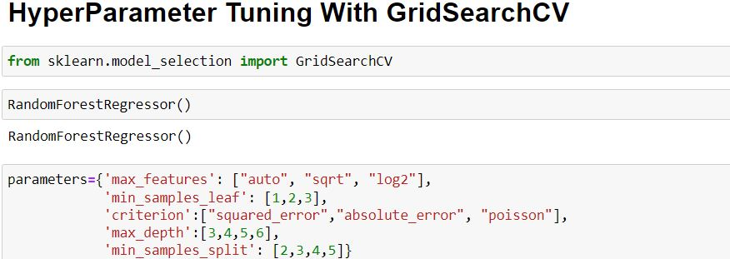
KEY METRICS FOR SUCCESS IN SOLVING PROBLEM UNDER CONSIDERATION
The key metrics used here were r2_score, cross_val_score, sd, MAE, MSE and RMSE. We tried to find out the best parameters and also to increase our scores by using Hyperparameter Tuning and we will be using GridSearchCV method.

Slide 34
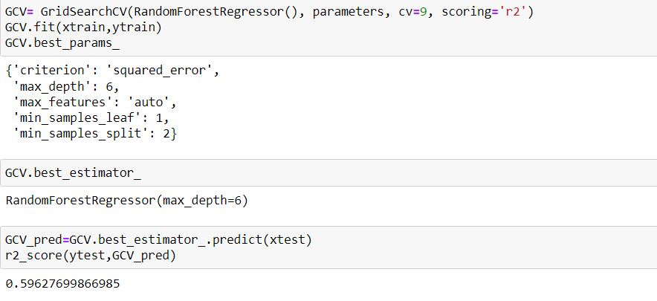

Slide 35
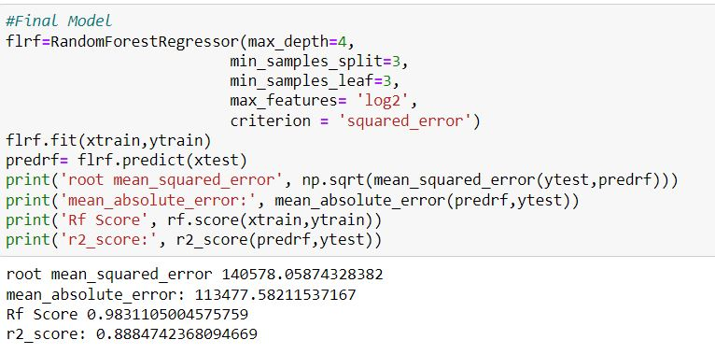
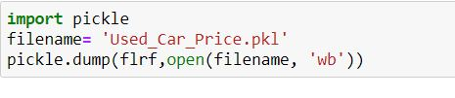
After tuning the Hyper parameters, we shall test it with our final model to get improved score of accuracy.
After tuning the Parameters and the final model is saved for future reference.

Slide 36
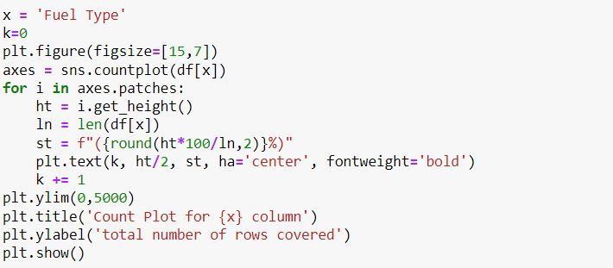
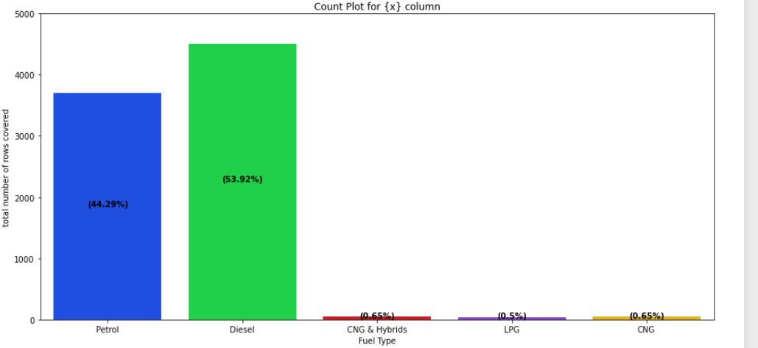
Visualizations
UNIVARIATE ANALYSIS

Slide 37
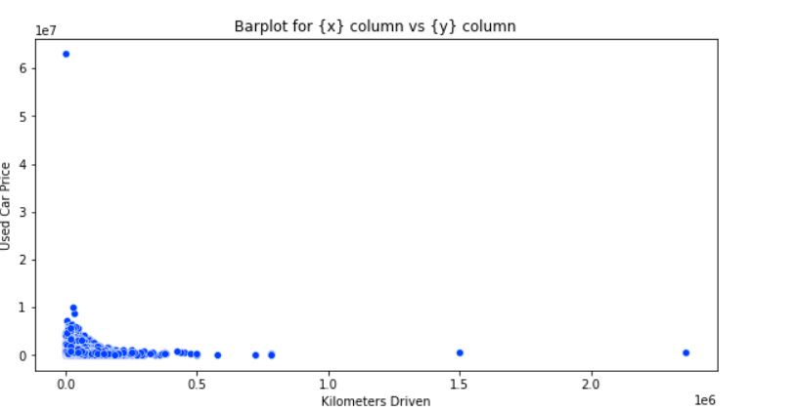
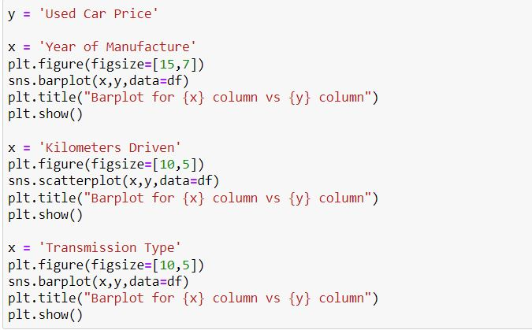
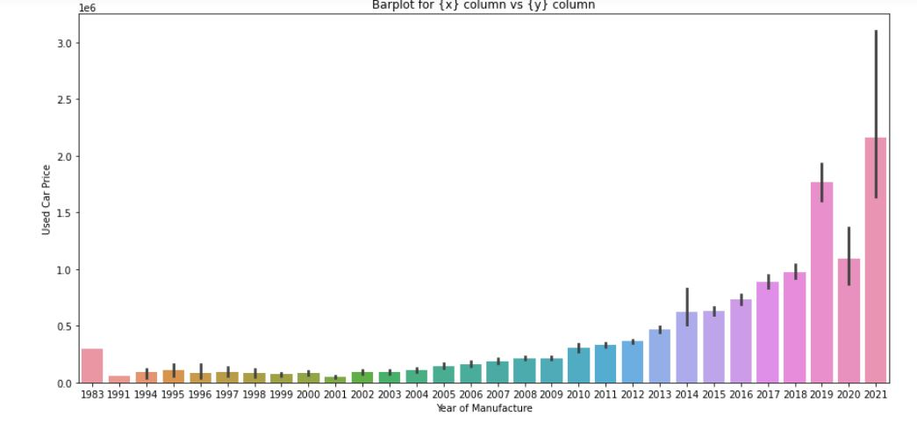
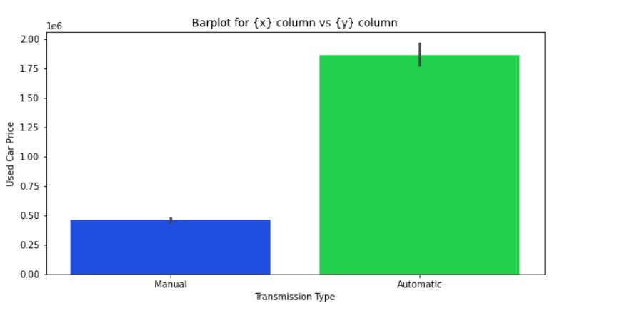

Slide 38
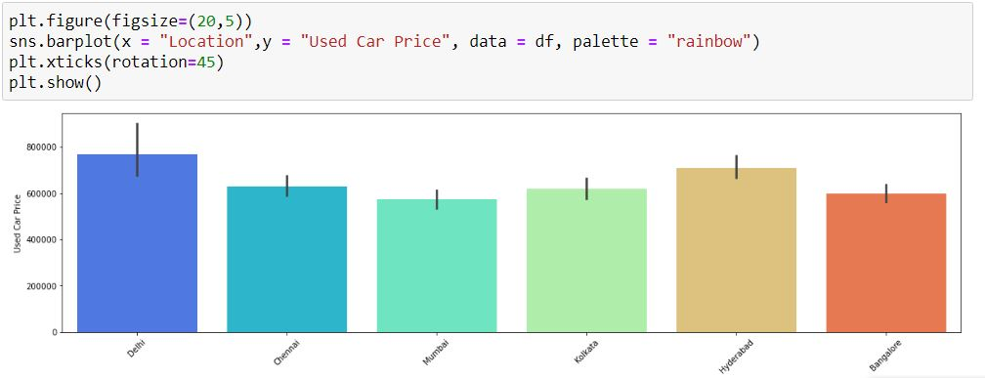
Bivariate analysis

Slide 39
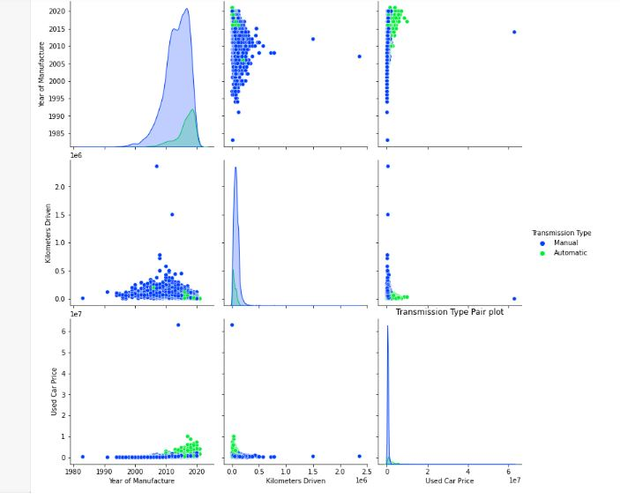

Slide 40
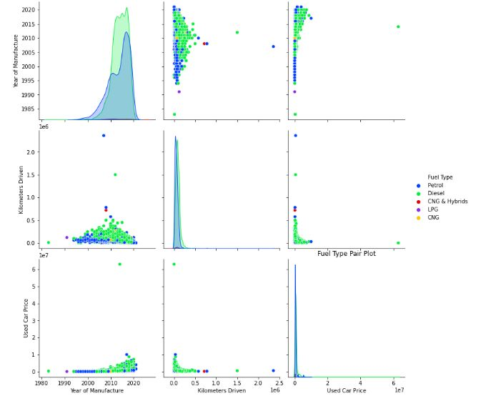

Slide 41

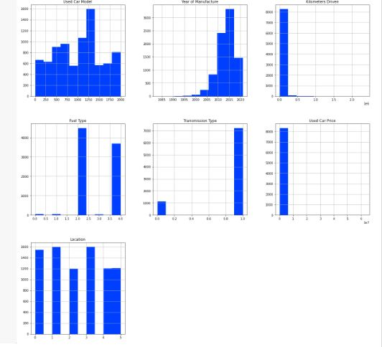

Slide 42
Conclusion
After the completion of this project, I got an insight on how to collect data, pre-processing the data, analyzing the data and building a model.
First, I collected the used cars data from different websites like OLX and it was done by using Web Scraping. The framework used for web scraping was Selenium, which has an advantage of automating the process of collecting data.
I have collected almost 8400 data which contained the selling price and other related features of used cars. Then the scrapped data was converted to data frame and saved in a csv file so that we can open it and analyse the data.
I found that Random Forest Regressor Algorithm was performing well according to their r2_score and cross validation scores. Then I performed Hyperparameter Tuning technique using GridSearchCV for getting the best parameters and improving the score.
I saved the final model in pkl format using the pickle library.

Slide 43
LIMITATIONS OF THIS WORK AND SCOPE FOR FUTURE WORK
The limitations we faced during this project were:
The website scrapping was challenging and took a lot of time and there were many issues in accessing to next page. Also need further practice in terms of various web scraping techniques. More negative correlated data were present than the positive correlated one's. Presence of outliers and skewness were detected and while dealing with them we had to lose a bit of valuable data.

Slide 44
Thank You

